Slide 1
ECE314 Lab 11 Overview
ODEs
Failure rate functions
Evolutionary games

Slide 2
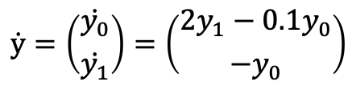
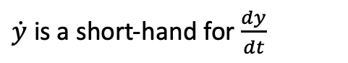
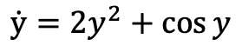
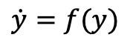
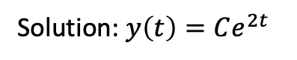
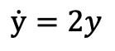
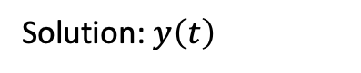
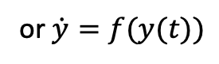
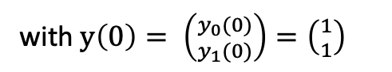
ODEs (Ordinary Differential Equations)
$$\dot{y}=f(y)$$
$\dot{y}$ is a short-hand for $\frac{dy}{dt}$
Solution: $y\left(t\right)$
or $\dot{y}=f(y(t))$
1-D Examples:
$$\dot{y}=2y$$
Solution: $y\left(t\right)=Ce^{2t}$
$$\dot{y}=2y^{2}+\cos{y}$$
2-D Example:
$$\dot{y}=\left({\dot{y_{0}} \atop \dot{y_{1}}}\right)=\left({2y_{1}−0.1y_{0} \atop −y_{0}}\right)$$
with $y\left(0\right)= \left({y_{0}(0) \atop y_{1}(0)}\right)=\left({1 \atop 1}\right)$
Closed-form solution is hard to find in general
In the lab, you will find the solution by numerical integration using Python

Slide 3

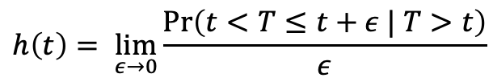
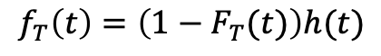
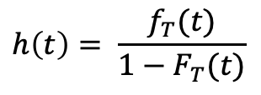
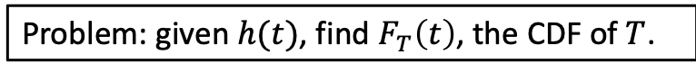
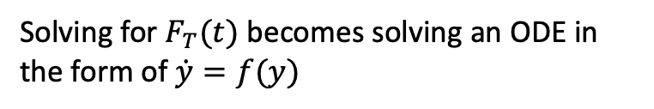
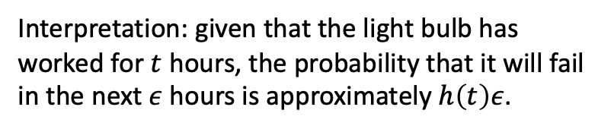
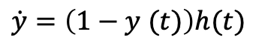
Failure rate function
Random variable $T$, the lifetime of a light bulb.
Interpretation: given that the light bulb has worked for $t$ hours, the probability that it will fail in the next $ε$ hours is approximately $h\left(t\right)ε$.
Failure rate
$$h\left(t\right)= \lim_{ε→0}{\frac{\operatorname{Pr}\left(t<T≤t+ε | T>t\right)}{ε}}$$
Problem: given $h(t)$, find $F_{T}\left(t\right)$, the CDF of $T$.
$$h\left(t\right)= \frac{f_{T}(t)}{1−F_{T}(t)}$$
$$f_{T}\left(t\right)=\left(1−F_{T}(t)\right)h(t)$$
Let $F_{T}(t)=y(t)$, then $f_{T}\left(t\right)=\frac{dy}{dt}= \dot{y}$
Solving for $F_{T}(t)$ becomes solving an ODE in the form of $\dot{y}=f(y)$
$$\dot{y}=\left(1−y (t)\right)h(t)$$

Slide 4
Evolutionary games: a cricket game

Slide 5
Evolutionary games: a cricket game
meets

Slide 6
Evolutionary games: a cricket game
meets

Slide 7
Evolutionary games: a cricket game
meets

Slide 8
Evolutionary games: a cricket game
meets

Slide 9
Evolutionary games: a cricket game
meets

Slide 10
Evolutionary games: a cricket game
meets

Slide 11
Evolutionary games: a cricket game
Fitness matrix
round | # of small crickets | # of large crickets
1 | 4 | 4
2
3
4
 | small | large
small | 5 | 1
large | 8 | 3
small meets small

Slide 12
Evolutionary games: a cricket game
Fitness matrix
round | # of small crickets | # of large crickets
1 | 4 | 4
2 | 14 | 4
3
4
 | small | large
small | 5 | 1
large | 8 | 3
small meets small

Slide 13
Evolutionary games: a cricket game
Fitness matrix
round | # of small crickets | # of large crickets
1 | 4 | 4
2 | 14 | 4
3
4
 | small | large
small | 5 | 1
large | 8 | 3
small meets small
small meets large

Slide 14
Evolutionary games: a cricket game
Fitness matrix
round | # of small crickets | # of large crickets
1 | 4 | 4
2 | 14 | 4
3 | 15 | 12
4
 | small | large
small | 5 | 1
large | 8 | 3
small meets small
small meets large

Slide 15
Evolutionary games: a cricket game
Fitness matrix
round | # of small crickets | # of large crickets
1 | 4 | 4
2 | 14 | 4
3 | 15 | 12
4
 | small | large
small | 5 | 1
large | 8 | 3
small meets small
small meets large
large meets large

Slide 16
Evolutionary games: a cricket game
Fitness matrix
round | # of small crickets | # of large crickets
1 | 4 | 4
2 | 14 | 4
3 | 15 | 12
4 | 15 | 18
 | small | large
small | 5 | 1
large | 8 | 3
small meets small
small meets large
large meets large

Slide 17
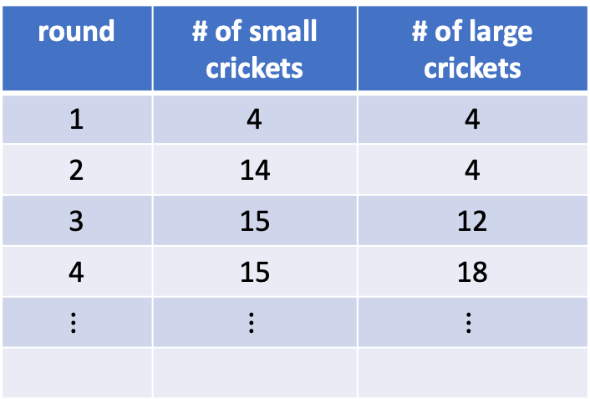
Evolutionary games: a cricket game
Fitness matrix
round | # of small crickets | # of large crickets
1 | 4 | 4
2 | 14 | 4
3 | 15 | 12
4 | 15 | 18
$$⋮$$ | $$⋮$$ | $$⋮$$
 | small | large
small | 5 | 1
large | 8 | 3
small meets small
small meets large
large meets large

Slide 18
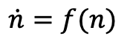
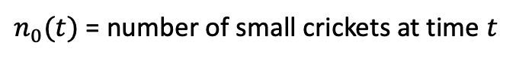
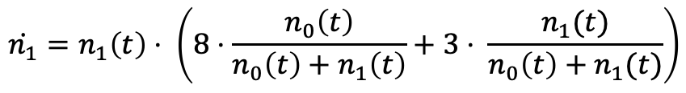
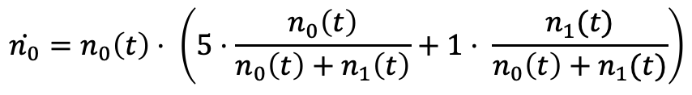
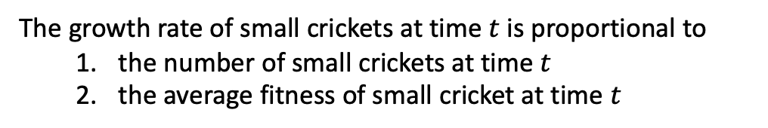
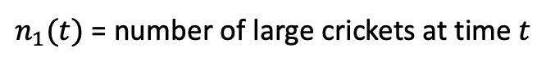
Evolutionary games: a cricket game
$n_{0}(t)$ = number of small crickets at time $t$
Fitness matrix
$n_{1}(t)$ = number of large crickets at time $t$
 | small | large
small | 5 | 1
large | 8 | 3
The growth rate of small crickets at time $t$ is proportional to
the number of small crickets at time $t$
the average fitness of small cricket at time $t$
$$\dot{n_{0}}=n_{0}\left(t\right)⋅ \left(5⋅\frac{n_{0}\left(t\right)}{n_{0}\left(t\right)+n_{1}\left(t\right)}+1⋅ \frac{n_{1}(t)}{n_{0}\left(t\right)+n_{1}(t)}\right)$$
$$\dot{n}=f(n)$$
$$\dot{n_{1}}=n_{1}\left(t\right)⋅ \left(8⋅\frac{n_{0}\left(t\right)}{n_{0}\left(t\right)+n_{1}\left(t\right)}+3⋅ \frac{n_{1}(t)}{n_{0}\left(t\right)+n_{1}(t)}\right)$$

Slide 19
Evolutionary games: a dove-hawk game
Fitness matrix
 | dove | hawk
dove | 3 | 1
hawk | 5 | 0

